Slide 1


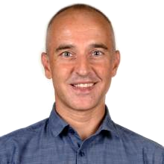
Lecture 4a
Neural Architectures
from Imagenet
Master in Big Data Solutions 2020-2021 - Artificial Intelligence
Xavier Giró
xavier.giro@bts.tech

Slide 2

Convolutional Neural Networks for Vision
LeNet-5: Several convolutional layers, combined with pooling layers, and followed by a small number of fully connected layers
#LeNet-5 LeCun, Y., Bottou, L., Bengio, Y., & Haffner, P. (1998). Gradient-based learning applied to document recognition. Proceedings of the IEEE, 86(11), 2278-2324.

Slide 3
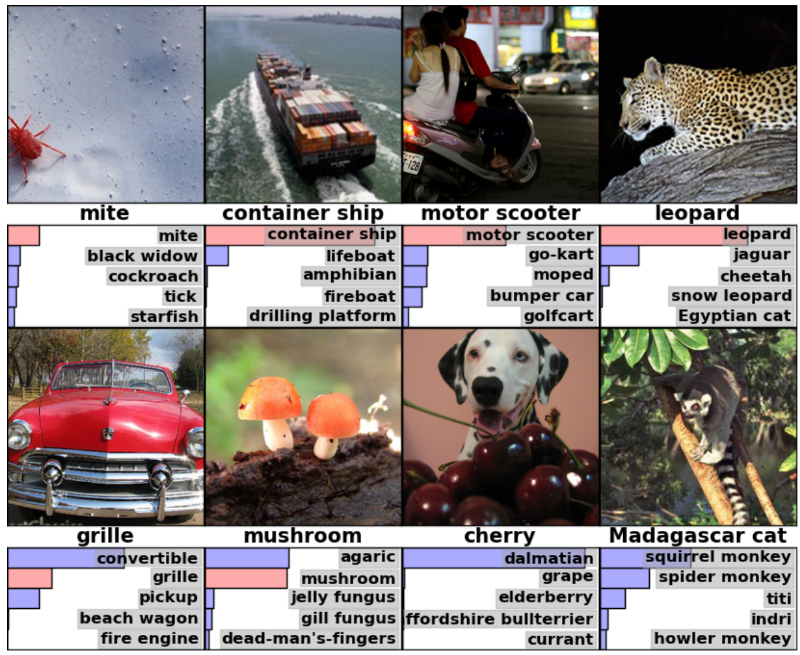

ImageNet Challenge
1,000 object classes (categories).
Images:
1.2 M train
100k test.

Slide 4
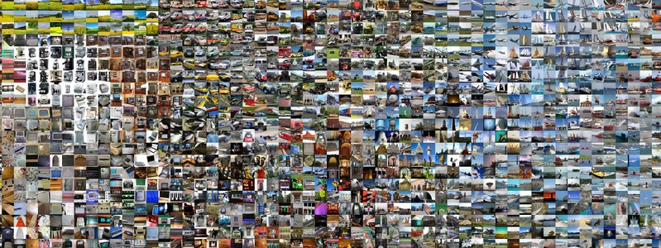
ImageNet Challenge
Russakovsky, Olga, Jia Deng, Hao Su, Jonathan Krause, Sanjeev Satheesh, Sean Ma, Zhiheng Huang et al. "Imagenet large scale visual recognition challenge." International Journal of Computer Vision 115, no. 3 (2015): 211-252. [web]

Slide 5
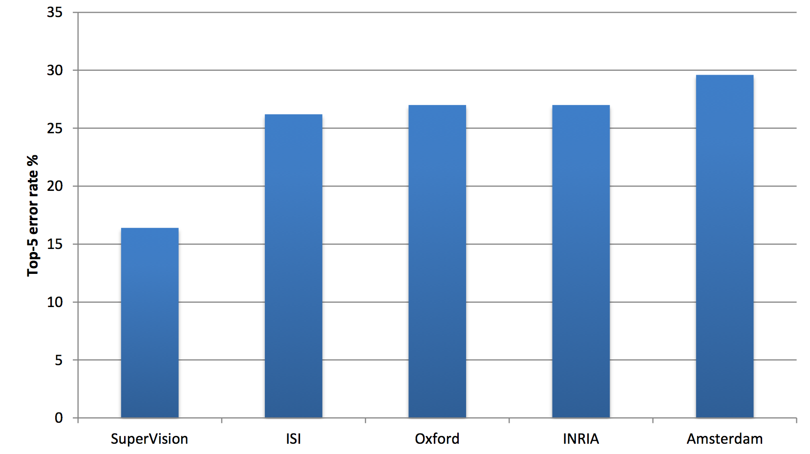
ImageNet Challenge: 2012
Based on SIFT + Fisher Vectors
-9.8%
Slide credit:
Rob Fergus (NYU)
Russakovsky, Olga, Jia Deng, Hao Su, Jonathan Krause, Sanjeev Satheesh, Sean Ma, Zhiheng Huang et al. "Imagenet large scale visual recognition challenge." International Journal of Computer Vision 115, no. 3 (2015): 211-252. [web]

Slide 6

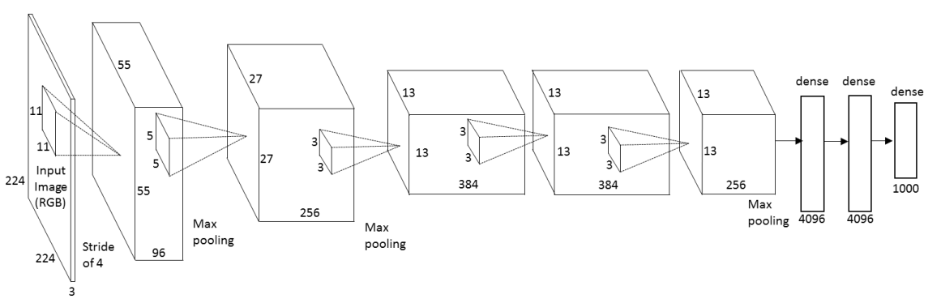
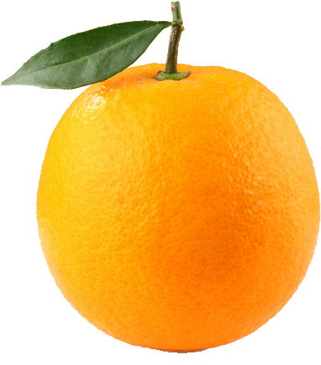
AlexNet (SuperVision)
#AlexNet Krizhevsky, Alex, Ilya Sutskever, and Geoffrey E. Hinton. "Imagenet classification with deep convolutional neural networks." NIPS 2012

Slide 7
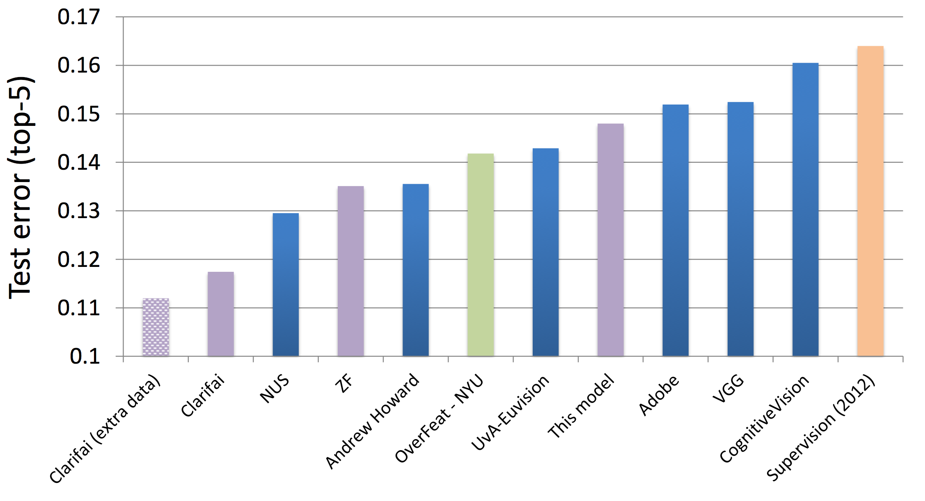
ImageNet Challenge: 2013
ImageNet Classification 2013
Slide credit:
Rob Fergus (NYU)
Russakovsky, Olga, Jia Deng, Hao Su, Jonathan Krause, Sanjeev Satheesh, Sean Ma, Zhiheng Huang et al. "Imagenet large scale visual recognition challenge." International Journal of Computer Vision 115, no. 3 (2015): 211-252. [web]

Slide 8
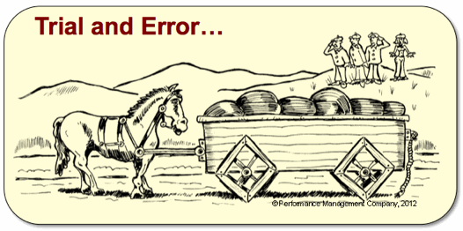


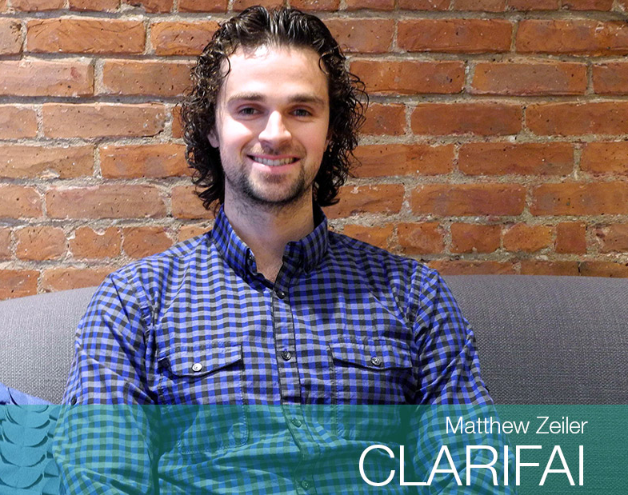
Zeiler-Fergus (ZF)
The development of better convnets is reduced to trial-and-error.
Visualization can help in proposing better architectures.
Zeiler, M. D., & Fergus, R. . Visualizing and understanding convolutional networks. ECCV 2014

Slide 9
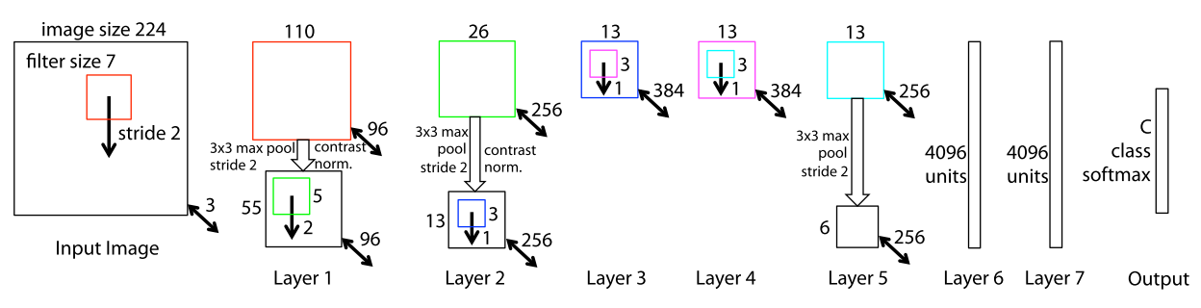
Zeiler-Fergus (ZF)
Zeiler, M. D., & Fergus, R. . Visualizing and understanding convolutional networks. ECCV 2014

Slide 10
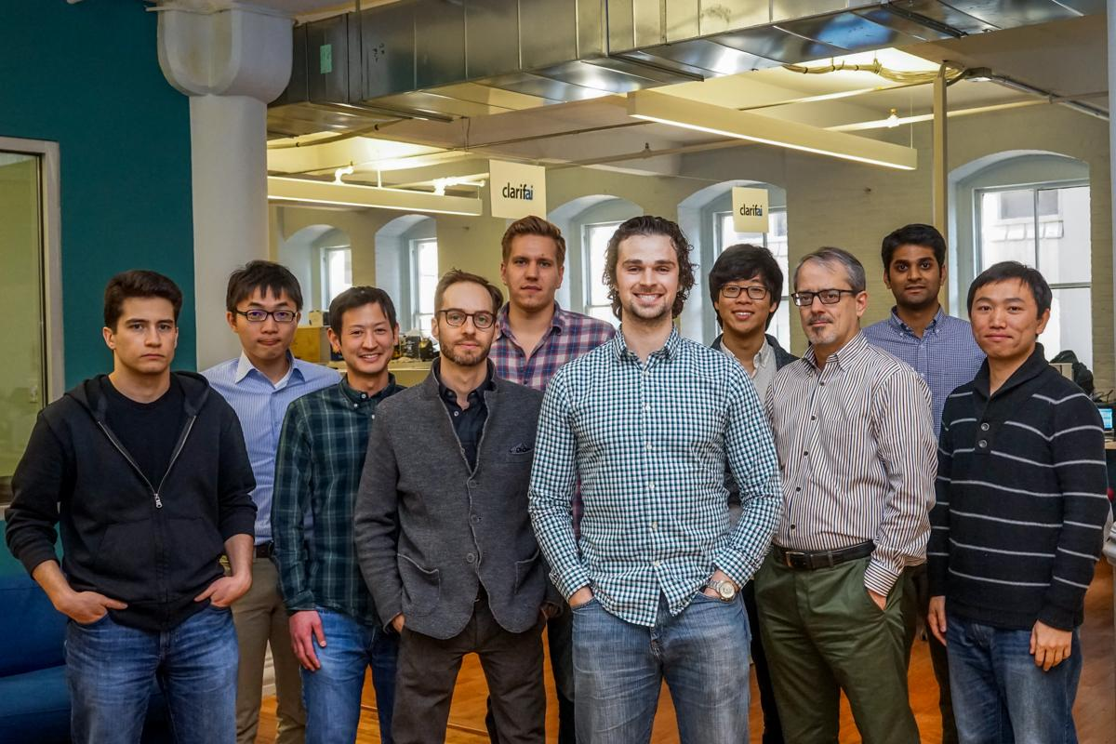

ImageNet Challenge: 2013
ImageNet Classification 2013
-5%
Russakovsky, Olga, Jia Deng, Hao Su, Jonathan Krause, Sanjeev Satheesh, Sean Ma, Zhiheng Huang et al. "Imagenet large scale visual recognition challenge." IJCV 2015. [web]

Slide 11
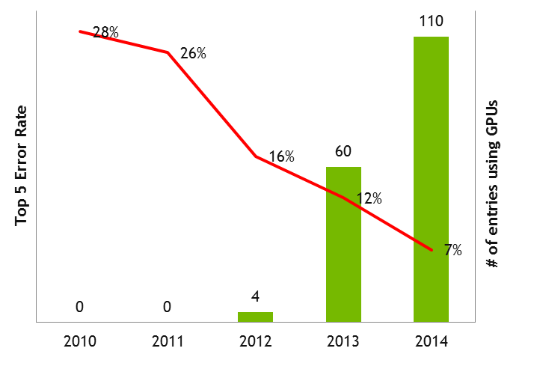
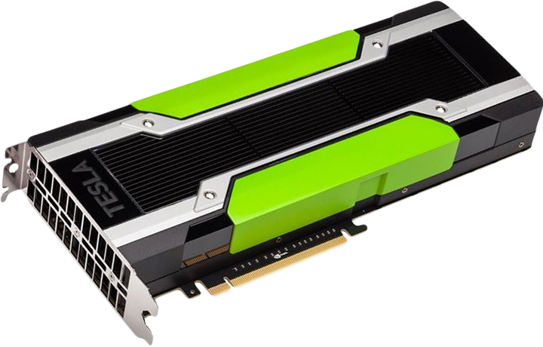
ImageNet Challenge: 2014
NVIDIA, “NVIDIA and IBM CLoud Support ImageNet Large Scale Visual Recognition Challenge” (2015)

Slide 12
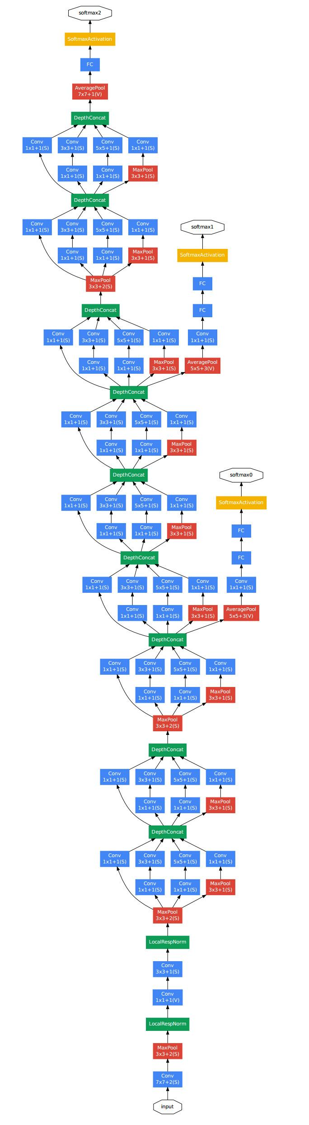
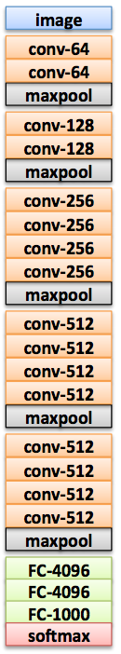
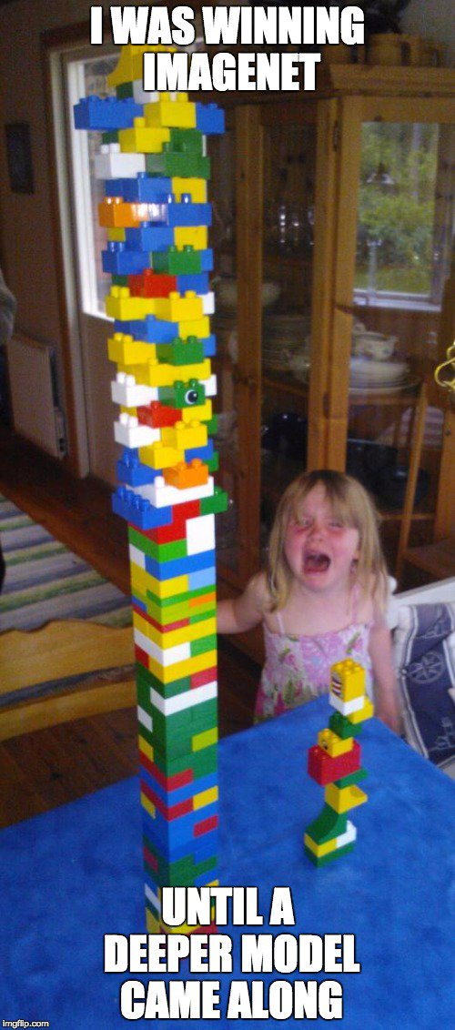
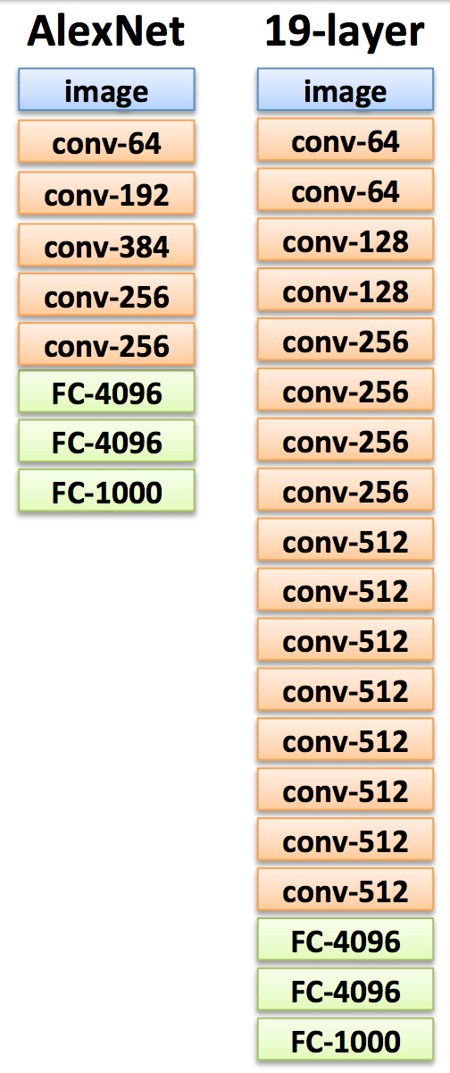
ImageNet Challenge: 2014

Slide 13

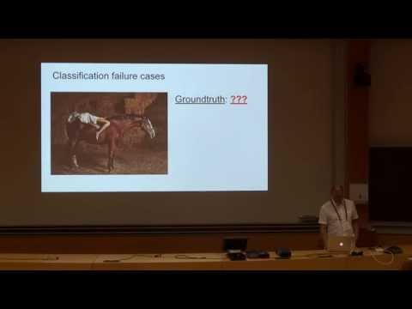




GoogleNet (Inception)
#Inception Szegedy, Christian, Wei Liu, Yangqing Jia, Pierre Sermanet, Scott Reed, Dragomir Anguelov, Dumitru Erhan, Vincent Vanhoucke, and Andrew Rabinovich. "Going deeper with convolutions." CVPR 2015. [video] [slides] [poster]

Slide 14
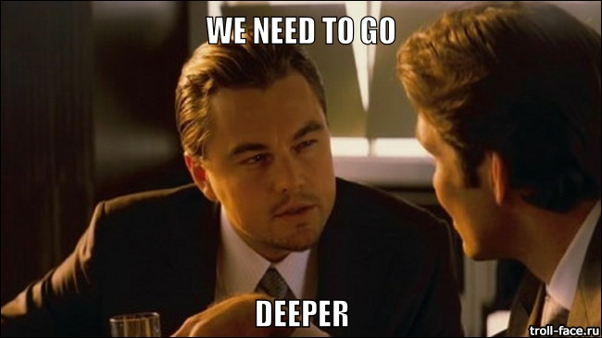
GoogleNet (Inception)
Movie: Inception (2010)

Slide 15
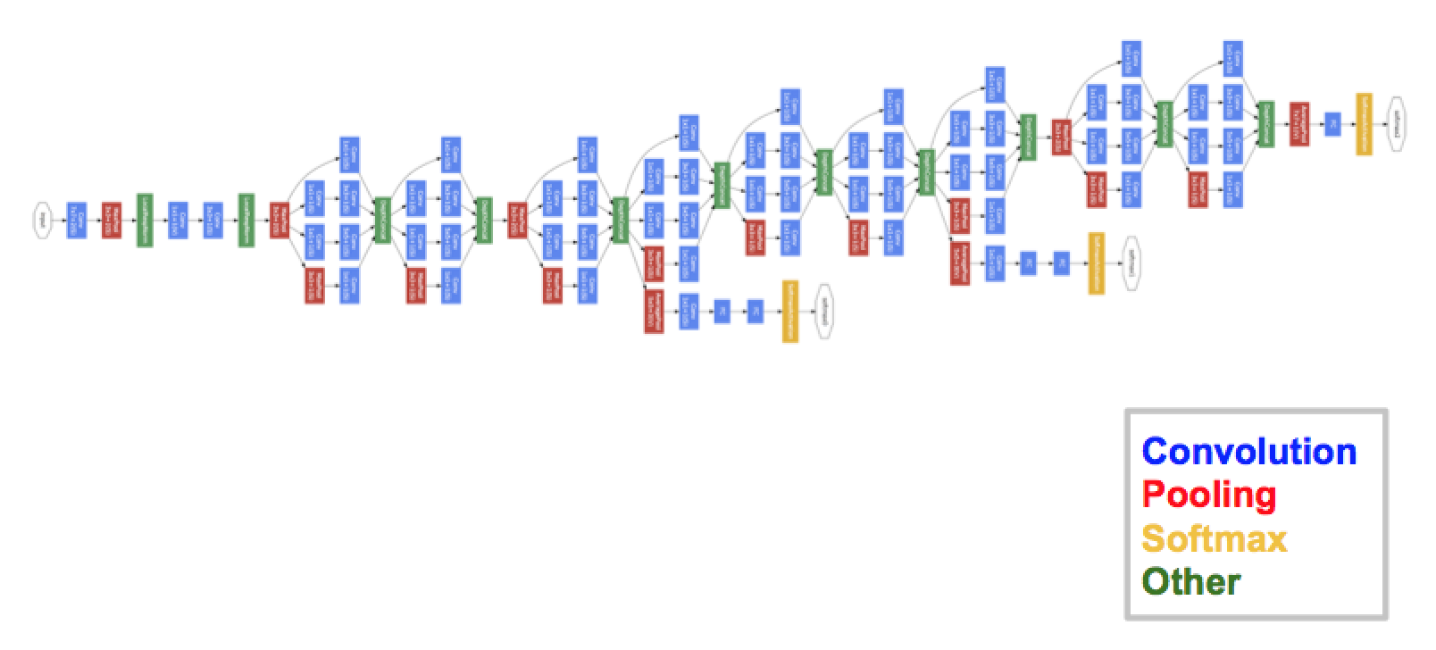
GoogleNet (Inception)
22 layers !
#Inception Szegedy, Christian, Wei Liu, Yangqing Jia, Pierre Sermanet, Scott Reed, Dragomir Anguelov, Dumitru Erhan, Vincent Vanhoucke, and Andrew Rabinovich. "Going deeper with convolutions." CVPR 2015. [video] [slides] [poster]

Slide 16
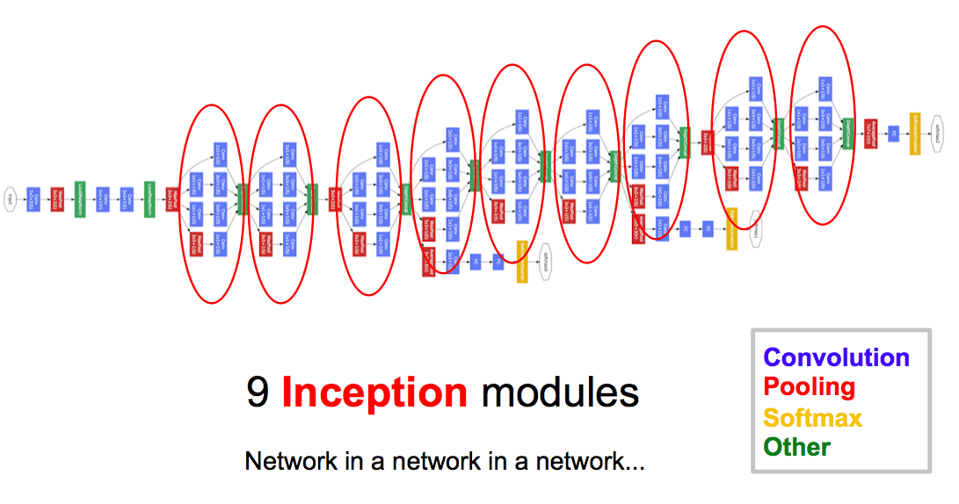
GoogleNet (Inception)

Slide 17
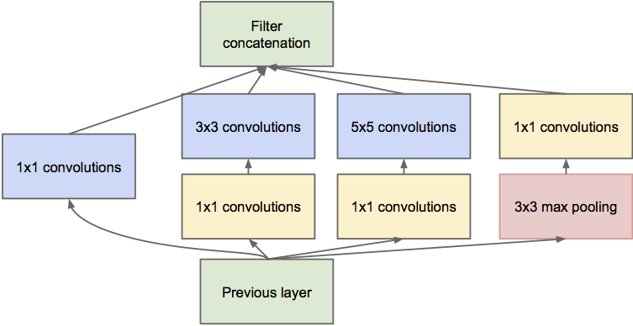
Pointwise convolutions (bottlenecks)
#NiN Lin, Min, Qiang Chen, and Shuicheng Yan. "Network in network." ICLR 2014.

Slide 18
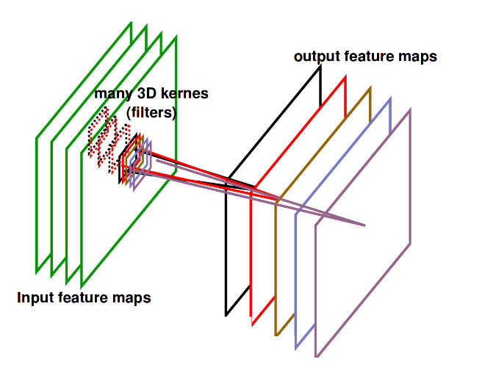
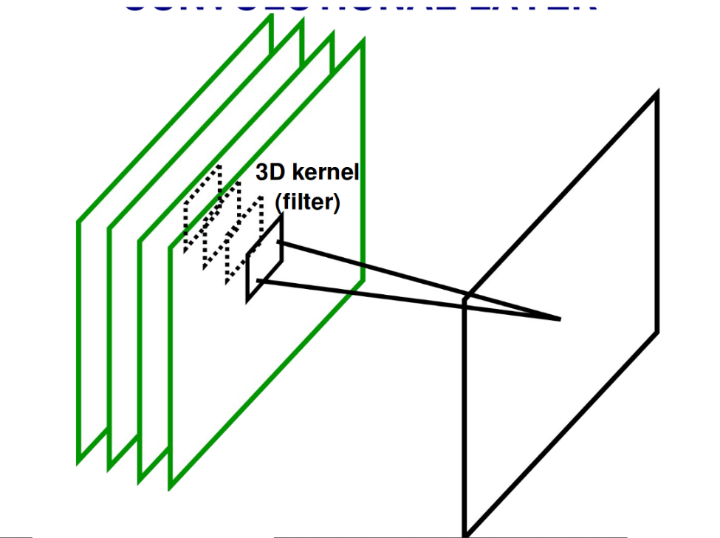
Pointise convolutions (bottlenecks)
Reminder: The amount of convolutional filters determines the amount of output channels.
Many feature maps
filter of depth=4
output feature map
Figure Credit: Ranzatto
#NiN Lin, Min, Qiang Chen, and Shuicheng Yan. "Network in network." ICLR 2014.

Slide 19
Multiple convolutional filter sizes (receptive field)
#NiN Lin, Min, Qiang Chen, and Shuicheng Yan. "Network in network." ICLR 2014.

Slide 20
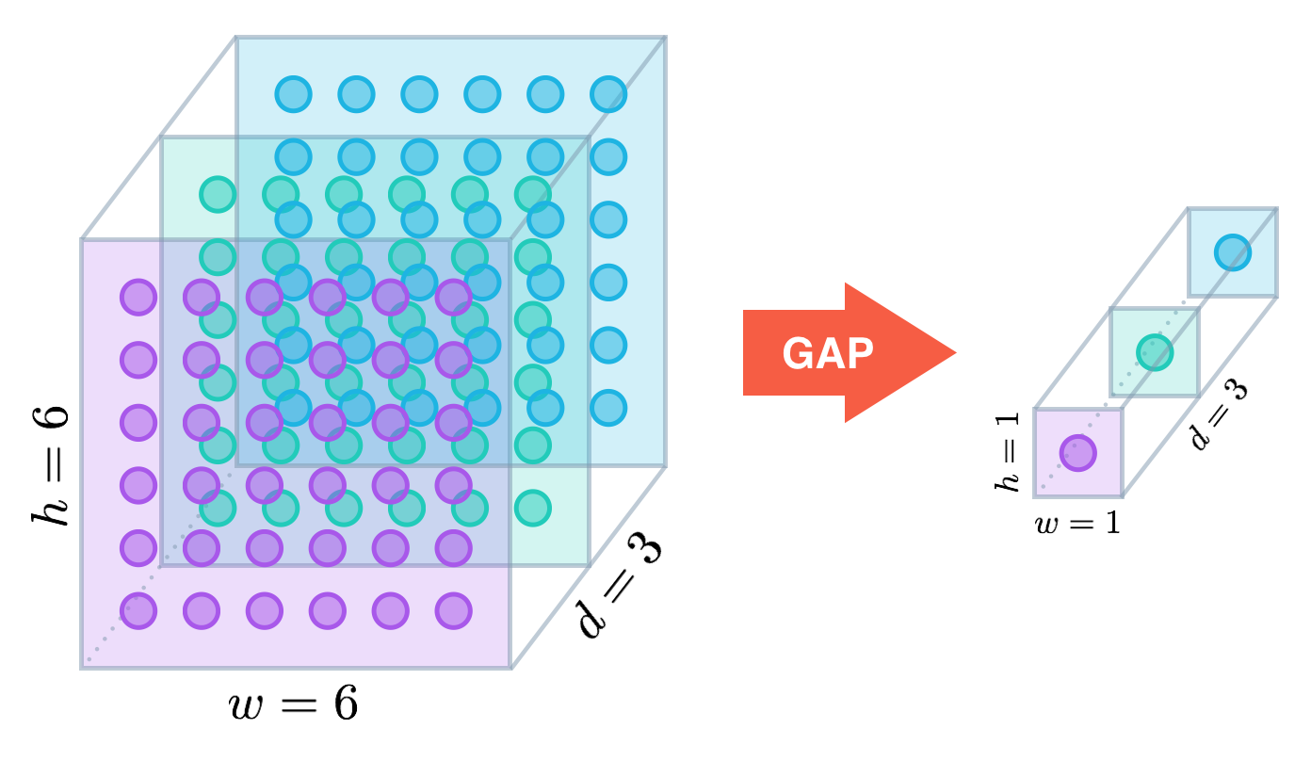
Global Average Pooling (GAP)
No fully connected layers needed (12 times fewer parameters than AlexNet. !)
Figure:
Alexis Cook
#NiN Lin, Min, Qiang Chen, and Shuicheng Yan. "Network in network." ICLR 2014.

Slide 21
GoogleNet (Inception)
Two Softmax classifiers at intermediate layers combat the vanishing gradient while providing regularization at training time.

Slide 22
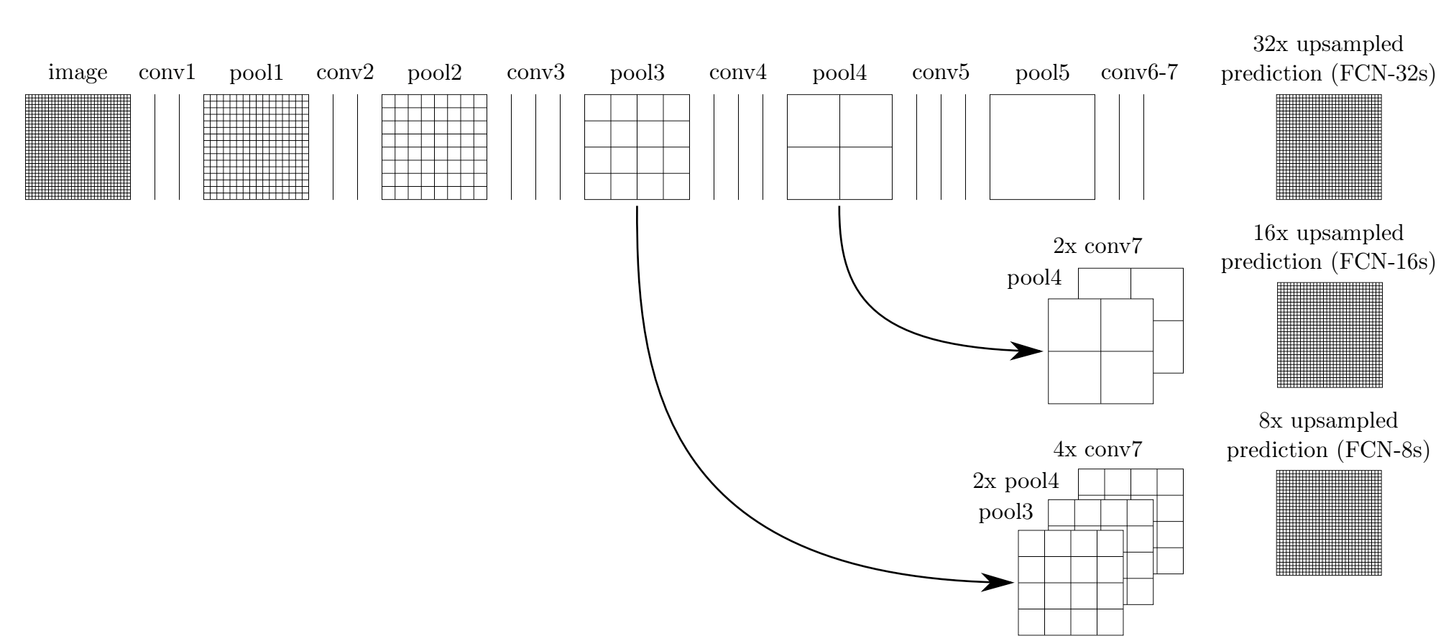
Skip connections to output (image segmentation)
#FCN Long, Jonathan, Evan Shelhamer, and Trevor Darrell. "Fully convolutional networks for semantic segmentation." CVPR 2015. [code]
Notes:
Our DAG nets learn to combine coarse, high layer information with fine, low layer information. Pooling and prediction layers are
shown as grids that reveal relative spatial coarseness, while intermediate layers are shown as vertical lines. First row (FCN-32s): Our singlestream net, described in Section 4.1, upsamples stride 32 predictions back to pixels in a single step. Second row (FCN-16s): Combining
predictions from both the final layer and the pool4 layer, at stride 16, lets our net predict finer details, while retaining high-level semantic
information. Third row (FCN-8s): Additional predictions from pool3, at stride 8, provide further precision.

Slide 23
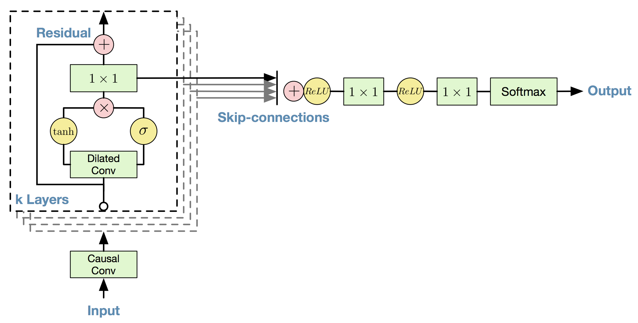
Skip connections to output (speech synthesis)
#WaveNet Van Den Oord, Aaron, Sander Dieleman, Heiga Zen, Karen Simonyan, Oriol Vinyals, Alex Graves, Nal Kalchbrenner, Andrew Senior, and Koray Kavukcuoglu. "Wavenet: A generative model for raw audio." Interspeech 2016.

Slide 24
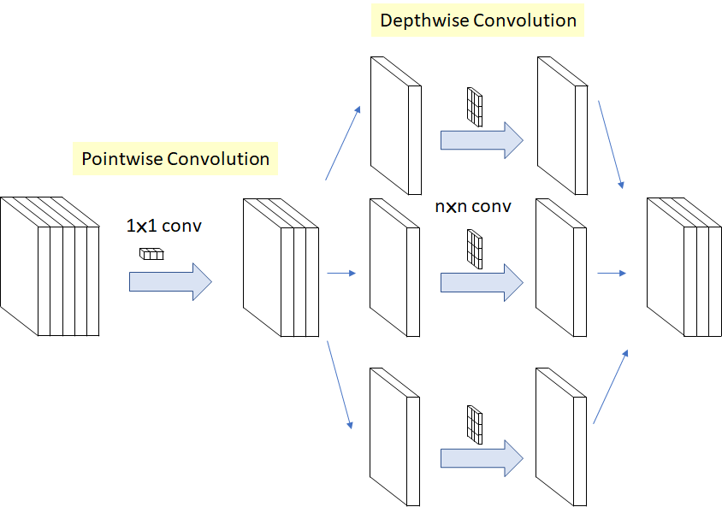
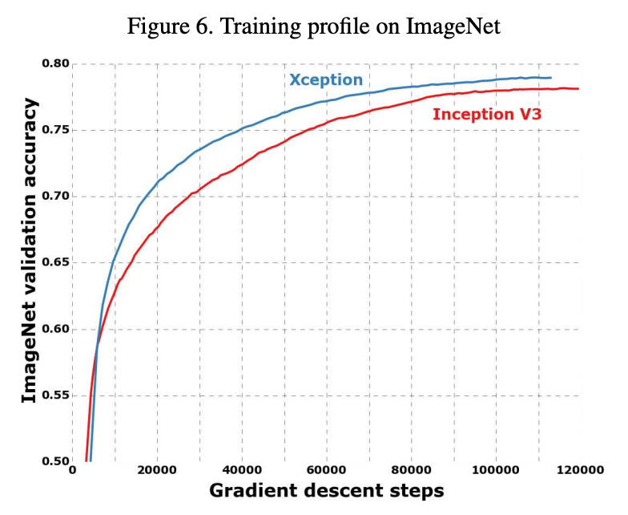
Depth-wise Separable Convolutions
Depth-wise (in channels) separable convolutions.
Figure: Sik-Ho Tsang
#XCeption Chollet, François. "Xception: Deep learning with depthwise separable convolutions." CVPR 2017.

Slide 25
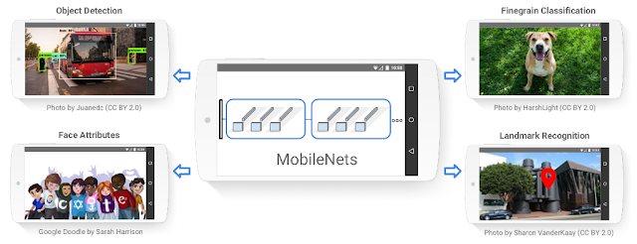
Depth-wise Separable Convolutions
MobileNets are streamlined architecture to build light weight deep neural networks.
#MobileNet1 Howard, A. G., Zhu, M., Chen, B., Kalenichenko, D., Wang, W., Weyand, T., ... & Adam, H. (2017). Mobilenets: Efficient convolutional neural networks for mobile vision applications. arXiv preprint arXiv:1704.04861. [blog]

Slide 26
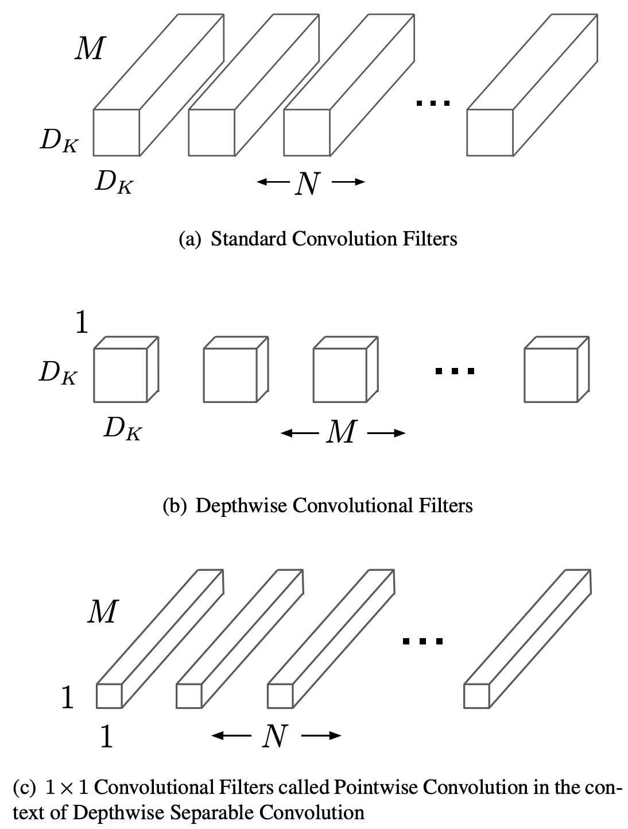
Standard Convolutions
Consider an input tensor of D_{F} x D_{F} x M, and assume padding and stride = 1.
Given the N convolutional kernels in the figure, what are the dimensions of the output tensor ?
( D_{F} x D_{F} ) x N filters
b) How many multiplications are needed to compute one value in the output tensor ?
D_{K} x D_{K} x M (kernel size)
c) How many multiplications are needed for the whole output tensor ?
( D_{K} x D_{K} ) x M x ( D_{F} x D_{F} ) x N
#MobileNet1 Howard, A. G., Zhu, M., Chen, B., Kalenichenko, D., Wang, W., Weyand, T., ... & Adam, H. (2017). Mobilenets: Efficient convolutional neural networks for mobile vision applications. arXiv preprint arXiv:1704.04861. [blog]

Slide 27
Depth-wise Separable Convolutions
Consider an input tensor of D_{F} x D_{F} x M, and assume padding and stride = 1.
Given the M separable convolutional kernels in the figure, what are the dimensions of the output tensor ?
( D_{F} x D_{F} ) x M (same as input)
b) How many multiplications are needed to compute one value in the output tensor ?
( D_{K} x D_{K} ) (kernel size)
c) How many multiplications are needed for the whole output tensor ?
( D_{K} x D_{K} ) x ( D_{F} x D_{F} ) x M
#MobileNet1 Howard, A. G., Zhu, M., Chen, B., Kalenichenko, D., Wang, W., Weyand, T., ... & Adam, H. (2017). Mobilenets: Efficient convolutional neural networks for mobile vision applications. arXiv preprint arXiv:1704.04861. [blog]

Slide 28
Depth-wise + Point-wise Separable Convolutions
Consider an input tensor of D_{F} x D_{F} x M, and assume padding and stride = 1.
Given the N convolutional kernels in the figure, what are the dimensions of the output tensor ?
( D_{F} x D_{F} ) x N filters
b) How many multiplications are needed to compute one value in the output tensor ?
M (kernel size)
c) How many multiplications are needed for the whole output tensor ?
M x ( D_{F} x D_{F} ) x N
#MobileNet1 Howard, A. G., Zhu, M., Chen, B., Kalenichenko, D., Wang, W., Weyand, T., ... & Adam, H. (2017). Mobilenets: Efficient convolutional neural networks for mobile vision applications. arXiv preprint arXiv:1704.04861. [blog]

Slide 29
Depth-wise + Point-wise Separable Convolutions
Compare the computational cost of a 2D conv. layer with 3x3 filters, for an input tensor of 14x14x512, whose dimensions must be kept at the output.
Standard Convolutions:
( D_{K} x D_{K} ) x M x ( D_{F} x D_{F} ) x N multiplications
Depth-wise convolutions Point-wise Convolutions
( D_{K} x D_{K} ) x ( D_{F} x D_{F} ) x M
M x ( D_{F} x D_{F} ) x N
#MobileNet1 Howard, A. G., Zhu, M., Chen, B., Kalenichenko, D., Wang, W., Weyand, T., ... & Adam, H. (2017). Mobilenets: Efficient convolutional neural networks for mobile vision applications. arXiv preprint arXiv:1704.04861. [blog]

Slide 30
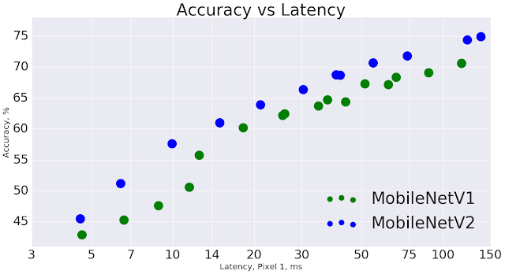
Point-wise + Depth-wise Separable Convolutions
Two global hyper-parameters efficiently trade off between latency and accuracy
#MobileNets Sandler, M., Howard, A., Zhu, M., Zhmoginov, A., & Chen, L. C. (2018). Mobilenetv2: Inverted residuals and linear bottlenecks. CVPR 2018 [blog v2]

Slide 31
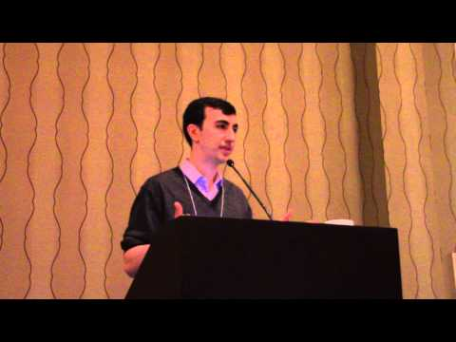


VGG
#VGG Simonyan, Karen, and Andrew Zisserman. "Very deep convolutional networks for large-scale image recognition." ICLR 2015. [video] [slides] [project]

Slide 32
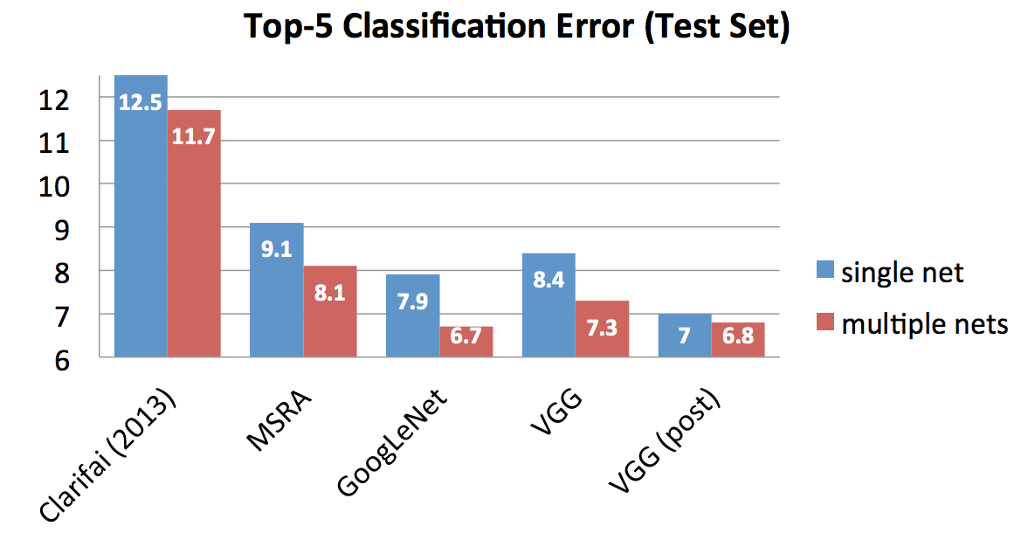
VGG
#VGG Simonyan, Karen, and Andrew Zisserman. "Very deep convolutional networks for large-scale image recognition." ICLR 2015. [video] [slides] [project]

Slide 33
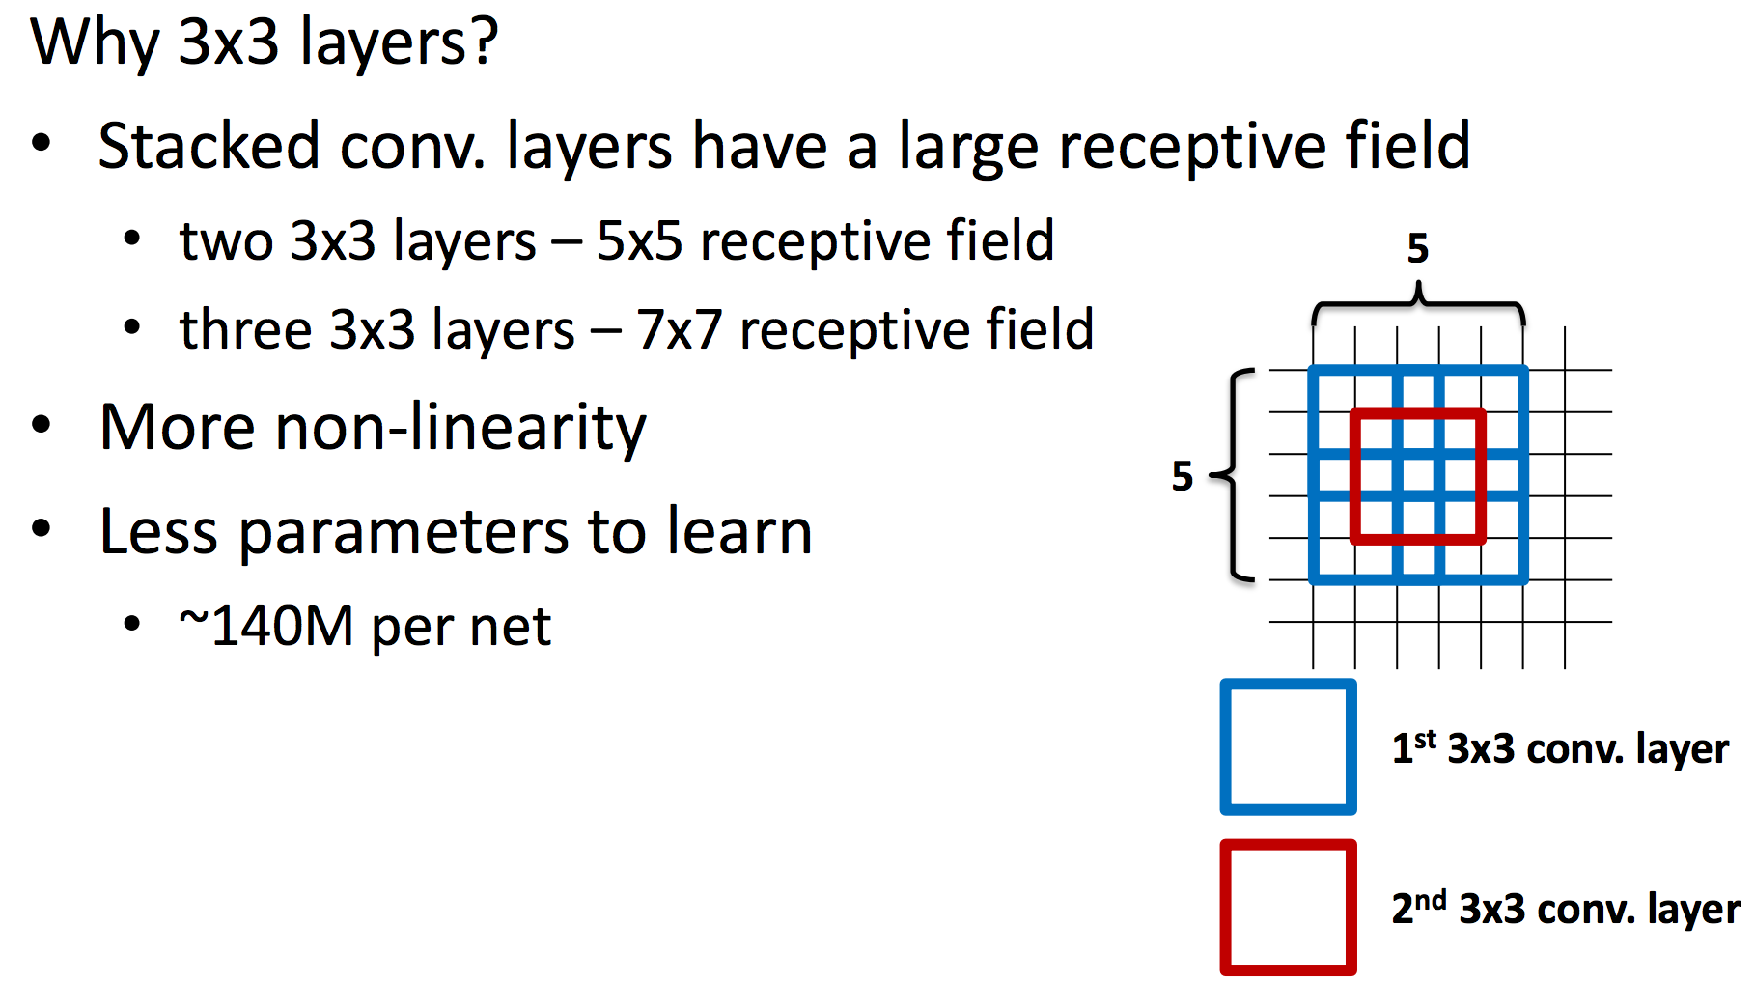
VGG: Stacked 3x3 convolutions
1 filter of 5x5 > 25 weights + 1 bias = 26 params
2 filters of 3x3 > 18 weights + 2 biases = 20 params
#VGG Simonyan, Karen, and Andrew Zisserman. "Very deep convolutional networks for large-scale image recognition." ICLR 2015. [video] [slides] [project]

Slide 34
VGG: Other details
No poolings between some convolutional layers.
Convolution strides of 1 (no skipping).
Simonyan, Karen, and Andrew Zisserman. "Very deep convolutional networks for large-scale image recognition." ICLR 2015. [video] [slides] [project]

Slide 35
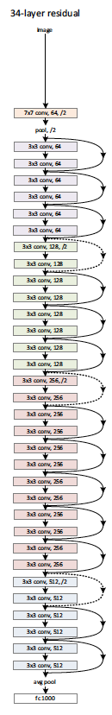
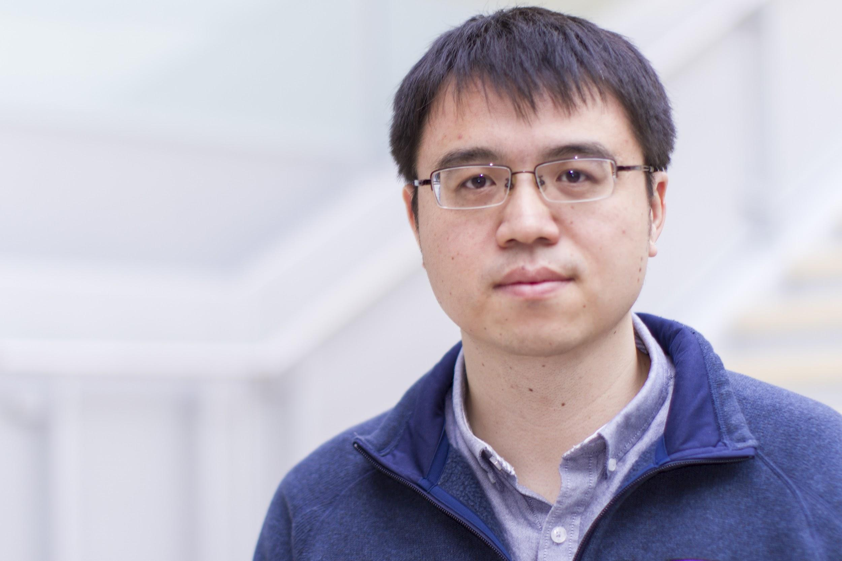

ImageNet Challenge: 2015
3.6% top 5 error…
with 152 layers !!

Slide 36
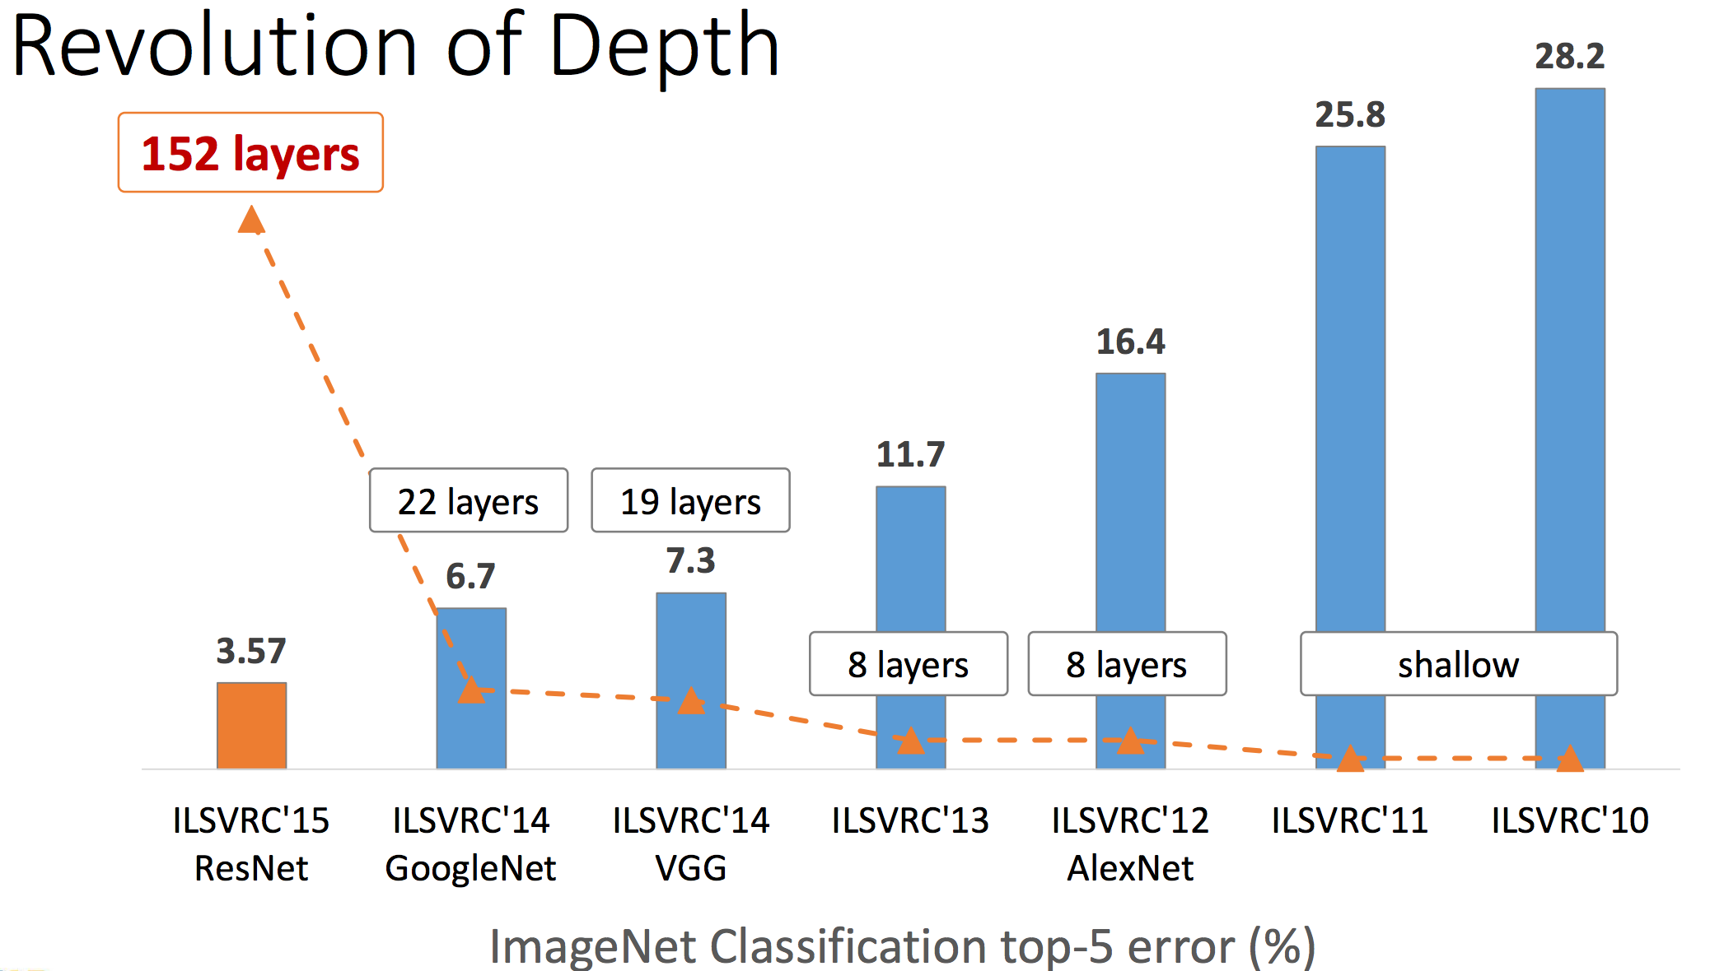
ResNet
He, Kaiming, Xiangyu Zhang, Shaoqing Ren, and Jian Sun. "Deep residual learning for image recognition." CVPR 2016. [slides]

Slide 37
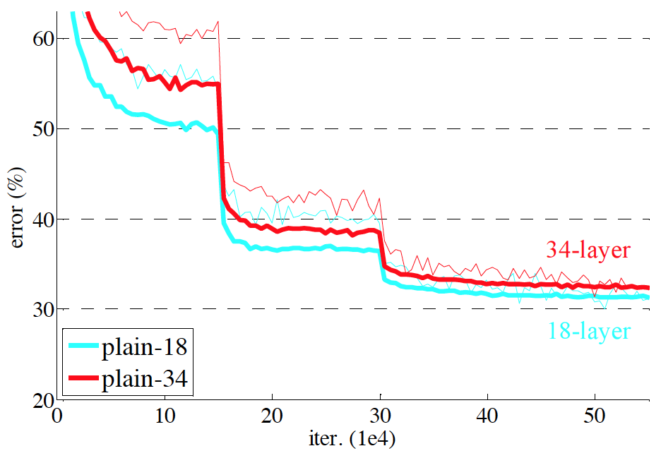
ResNet
Challenge: Deeper networks (34 is deeper than 18) are more difficult to train.
He, Kaiming, Xiangyu Zhang, Shaoqing Ren, and Jian Sun. "Deep residual learning for image recognition." CVPR 2016. [slides]

Slide 38
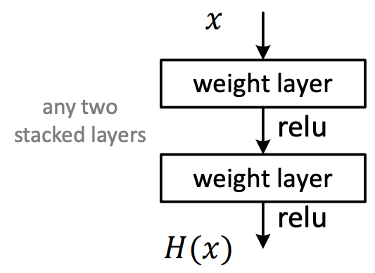
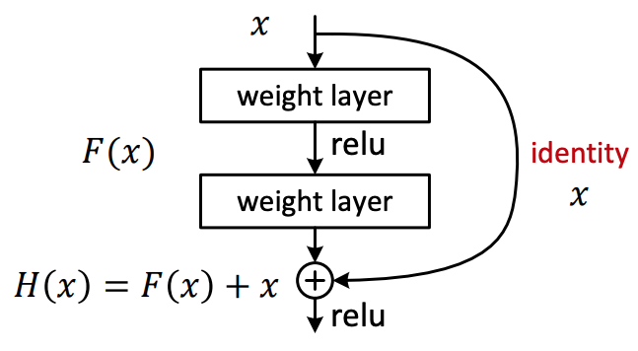
ResNet
Plain Net
Residual Net
Residual learning: reformulate the layers as learning residual functions, F(x) with respect to the identity, instead of learning unreferenced functions H(x)
He, Kaiming, Xiangyu Zhang, Shaoqing Ren, and Jian Sun. "Deep residual learning for image recognition." CVPR 2016. [slides]

Slide 39
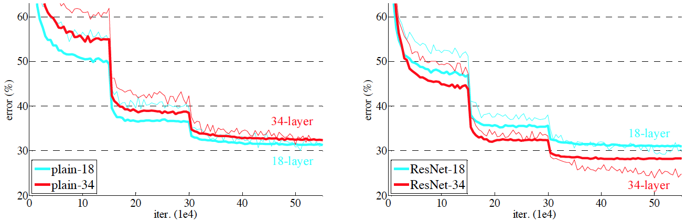
ResNet
Solution: Replace plain layer for residual layers.
Non-Residual connections
Residual connections
He, Kaiming, Xiangyu Zhang, Shaoqing Ren, and Jian Sun. "Deep residual learning for image recognition." CVPR 2016. [slides]

Slide 40
ResNet
Why ResNets train better ?:
“We hypothesize that it is easier to optimize the residual mapping than to optimize the original, unreferenced mapping. To the extreme, if an identity mapping were optimal (given x return x), it would be easier to push F(x) to zero than to fit an identity mapping by a stack of nonlinear layers”
He, Kaiming, Xiangyu Zhang, Shaoqing Ren, and Jian Sun. "Deep residual learning for image recognition." CVPR 2016. [slides]

Slide 41
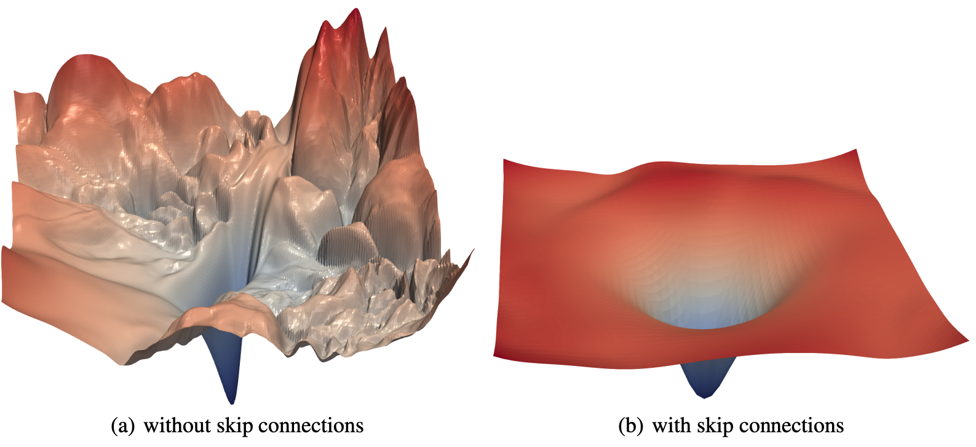
ResNet
The loss surfaces of ResNet-56 with/without skip connections
Hao Li, Zheng Xu, Gavin Taylor, Christoph Studer and Tom Goldstein. Visualizing the Loss Landscape of Neural Nets. NeurIPS, 2018. [code] [poster]

Slide 42
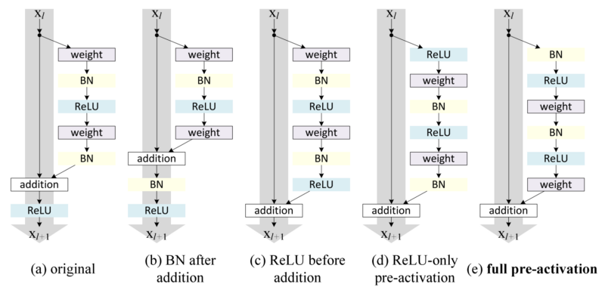
ResNet
It has been observed that pre-activations with batch normalizations give the best results in general
He, K., Zhang, X., Ren, S., & Sun, J. “Identity mappings in deep residual networks”. ECCV 2016.

Slide 43
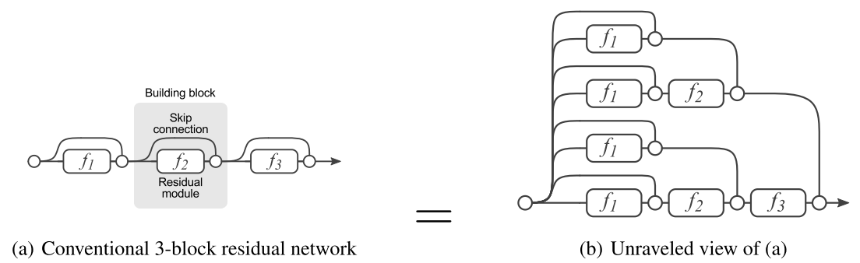
ResNet
After we unroll the network architecture, it is quite clear that a ResNet architecture with i residual blocks has 2 ** i different paths (because each residual block provides two independent paths).
Veit, Andreas, Michael J. Wilber, and Serge Belongie. "Residual networks behave like ensembles of relatively shallow networks." NIPS 2016.

Slide 44
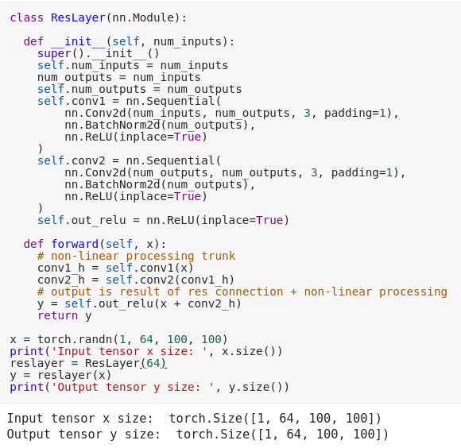

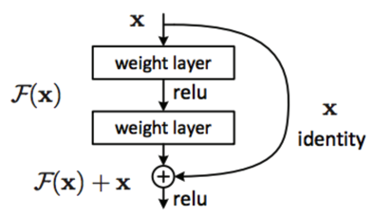
ResNet
Slide credit: Santiago Pascual (UPC School 2019)

Slide 45
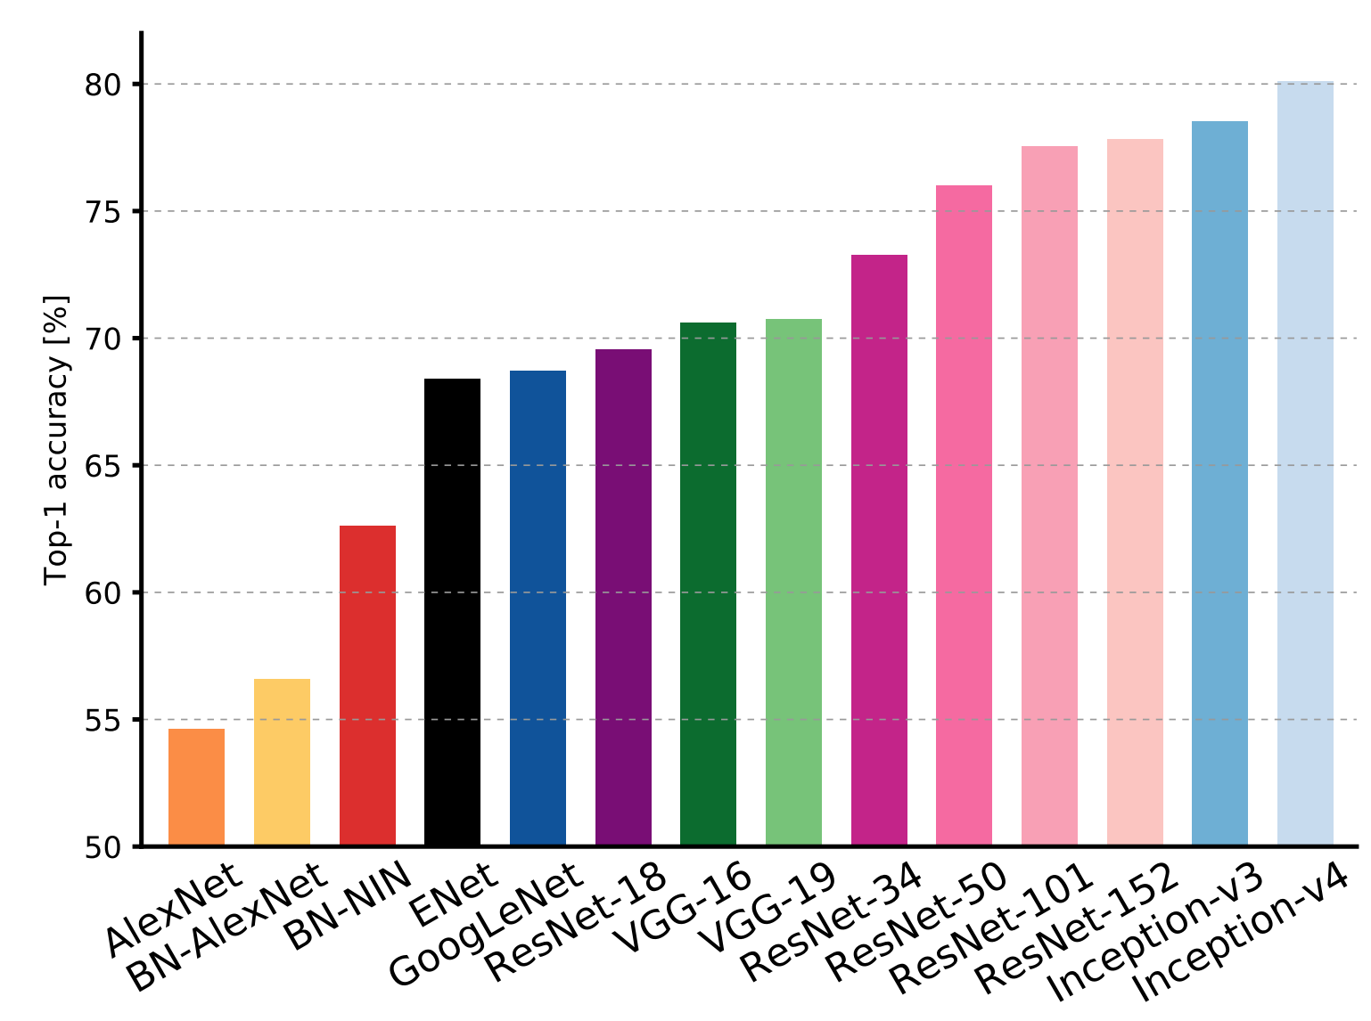
ResNet
Canziani, Alfredo, Adam Paszke, and Eugenio Culurciello. "An analysis of deep neural network models for practical applications." arXiv preprint arXiv:1605.07678 (2016).

Slide 46
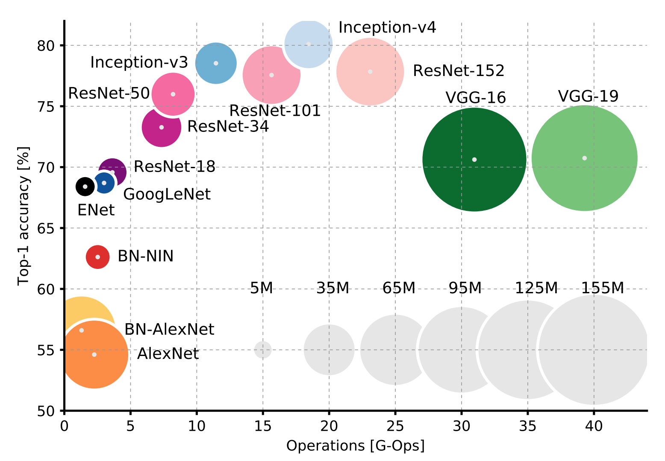
ResNet
Canziani, Alfredo, Adam Paszke, and Eugenio Culurciello. "An analysis of deep neural network models for practical applications." arXiv preprint arXiv:1605.07678 (2016).

Slide 47
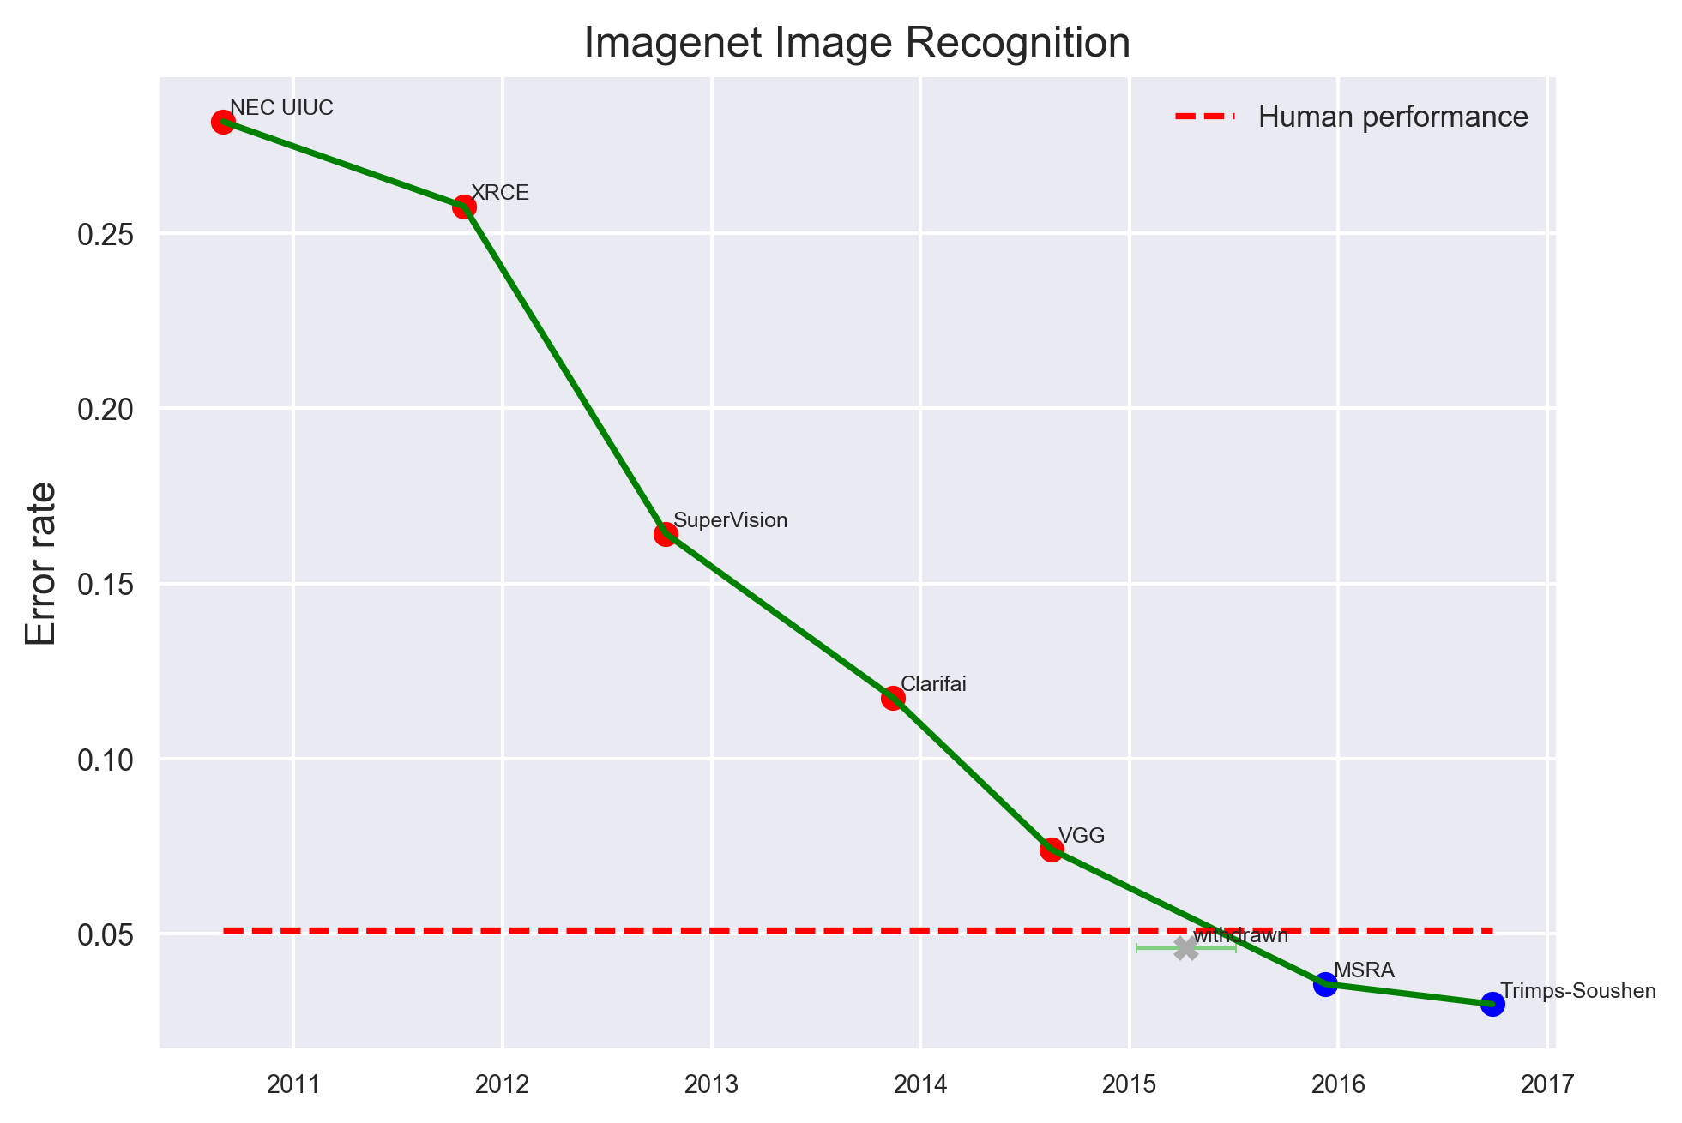
ResNet
Electronic Frontier Foundation: “Measuring the Progress of AI Research” (2017)

Slide 48



ResNext: Residual Connections + Separable convs.
#ResNext Xie, Saining, Ross Girshick, Piotr Dollár, Zhuowen Tu, and Kaiming He. "Aggregated residual transformations for deep neural networks." CVPR 2017 [code]

Slide 49
Learn more on Residual Networks
Summary
Vincent Fung, “An Overview of ResNet and its Variants” (2017)
Papers
Zagoruyko, S., & Komodakis, N. (2016). Wide residual networks. arXiv preprint arXiv:1605.07146.
Xie, Saining, Ross Girshick, Piotr Dollár, Zhuowen Tu, and Kaiming He. "Aggregated residual transformations for deep neural networks." CVPR 2017.
Han, Dongyoon, Jiwhan Kim, and Junmo Kim. "Deep pyramidal residual networks." CVPR 2017.
Yu, Fisher, Vladlen Koltun, and Thomas Funkhouser. "Dilated residual networks." CVPR 2017.
Wu, Zifeng, Chunhua Shen, and Anton Van Den Hengel. "Wider or deeper: Revisiting the resnet model for visual recognition." Pattern Recognition 90 (2019): 119-133.

Slide 50

Skip connections to intermediate layers (image segmentation)
#U-Net Ronneberger, Olaf, Philipp Fischer, and Thomas Brox. "U-net: Convolutional networks for biomedical image segmentation." MICCAI 2015

Slide 51


Stacked Hourglass Networks
Newell, Alejandro, Kaiyu Yang, and Jia Deng. "Stacked hourglass networks for human pose estimation." ECCV 2016.

Slide 52

Skip connections to intermediate layers (image segmentation)
#RSIS Amaia Salvador, Míriam Bellver, Víctor Campos, Manel Baradad, Ferran Marqués, Jordi Torres, Xavier Giró-i-Nieto, “Recurrent Neural Networks for Semantic Instance Segmentation”. NIPS Women in Machine Learning 2017.

Slide 53


Skip connections to intermediate layers (speech denoising)
Pascual, S., Bonafonte, A., & Serrà, J. “SEGAN: Speech Enhancement Generative Adversarial Network”. Interspeech 2017. [code]

Slide 54

Dense Blocks
The input of each layer consists of the feature maps of all earlier layer, and its output is passed to each subsequent layer.
#DenseNet Huang, Gao, Zhuang Liu, Kilian Q. Weinberger, and Laurens van der Maaten. "Densely connected convolutional networks." CVPR 2017. [code]

Slide 55
Dense Blocks
Growth rate (k): If each function H_{l} produces k feature maps, it follows that the l^{th} layer has k₀ + k ×(l−1) input feature-maps, where k₀ is the number of channels in the input layer.
Layer (l) | Growth rate (k) | # input f. maps
0 | k₀=6 | -
1 | 4 | 6
2 | 4 | 10
3 | 4 | 14
4 | 4 | 18
#DenseNet Huang, Gao, Zhuang Liu, Kilian Q. Weinberger, and Laurens van der Maaten. "Densely connected convolutional networks." CVPR 2017. [code]

Slide 56

Dense Blocks
DenseNet is divided into multiple densely connected dense blocks to facilitate spatial pooling.
#DenseNet Huang, Gao, Zhuang Liu, Kilian Q. Weinberger, and Laurens van der Maaten. "Densely connected convolutional networks." CVPR 2017. [code]

Slide 57

DenseNet
#DenseNet Huang, Gao, Zhuang Liu, Kilian Q. Weinberger, and Laurens van der Maaten. "Densely connected convolutional networks." CVPR 2017. [code]

Slide 58

DenseNet
#DenseNet Huang, Gao, Zhuang Liu, Kilian Q. Weinberger, and Laurens van der Maaten. "Densely connected convolutional networks." CVPR 2017. [code]

Slide 59

DenseNet
#DenseNet Huang, Gao, Zhuang Liu, Kilian Q. Weinberger, and Laurens van der Maaten. "Densely connected convolutional networks." CVPR 2017. [code]

Slide 60

DenseNet
The loss surfaces of ResNet-110 (no skip connections) and DenseNet for CIFAR-10.
Hao Li, Zheng Xu, Gavin Taylor, Christoph Studer and Tom Goldstein. Visualizing the Loss Landscape of Neural Nets. NeurIPS, 2018. [code] [poster]

Slide 61

DenseNets (+U-Net) for Image Segmentation
Jégou, Simon, Michal Drozdzal, David Vazquez, Adriana Romero, and Yoshua Bengio. "The One Hundred Layers Tiramisu: Fully Convolutional DenseNets for Semantic Segmentation." CVPRW 2017 [code] [slides]

Slide 62




Neural Architecture Search (NAS)
Neural Architecture Search (AutoML): Instead of manually defining the architectures, allow software to search among a set of plausible architectures.

Slide 63

Neural Architecture Search (NAS)- Evolutionary
#AutoML Real, Esteban, Sherry Moore, Andrew Selle, Saurabh Saxena, Yutaka Leon Suematsu, Jie Tan, Quoc V. Le, and Alexey Kurakin. "Large-scale evolution of image classifiers." ICML 2017. [blog]

Slide 64

Neural Architecture Search (NAS)
#NasNet Zoph, Barret, Vijay Vasudevan, Jonathon Shlens, and Quoc V. Le. "Learning transferable architectures for scalable image recognition." CVPR 2018.
Notes:
Accuracy versus computational demand (left) and number of parameters (right) across top performing published CNN architectures on ImageNet 2012 ILSVRC challenge prediction task. Computational demand is measured in the number of floating-point multiplyadd operations to process a single image. Black circles indicate previously published results and red squares highlight our proposed models.

Slide 65

EfficientNet
Careful scaling of network width, depth and resolution.
#EfficientNet Tan, M., & Le, Q. V. (2019). Efficientnet: Rethinking model scaling for convolutional neural networks. ICML 2019. [blog]

Slide 66

EfficientNet
Tan, M., & Le, Q. V. (2019). Efficientnet: Rethinking model scaling for convolutional neural networks. ICML 2019.

Slide 67


Neural Architecture Search vs Sustainability
Strubell, Emma, Ananya Ganesh, and Andrew McCallum. "Energy and Policy Considerations for Deep Learning in NLP." ACL 2019. [tweet]

Slide 68

Learn more
Jeff Dean (Google AI), “AutoML at Google and Future Directions”. ICML 2019.

Slide 69

Detailed overview
Papers with code: Image classification on ImageNet

Slide 70

Semi-supervised learning by adding more data
#NoisyStudent Xie, Q., Hovy, E., Luong, M. T., & Le, Q. V. (2019). Self-training with Noisy Student improves ImageNet classification. CVPR 2020. [code] [tweet]

Slide 71


